Slide 1
Agile Software Development
CSC 403 / CYEN 481

Slide 2
Manifesto for Agile Software Development
We are uncovering better ways of developing software by doing it and helping others do it. Through this work we have come to value:
Individuals and interactions over processes and tools Working software over comprehensive documentation Customer collaboration over contract negotiation Responding to change over following a plan
That is, while there is value in the items on the right, we value the items on the left more.
http://agilemanifesto.org/

Slide 3
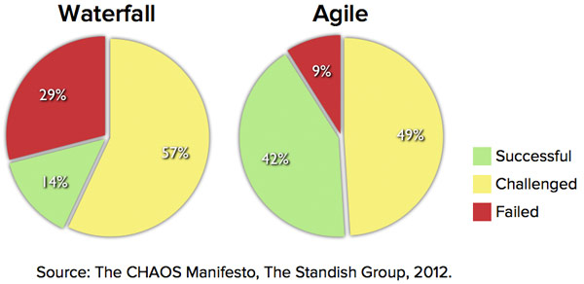
Why Do We Use Agile?
With successful defined as:
“on time, on budget, and with all planned features.“

Slide 4
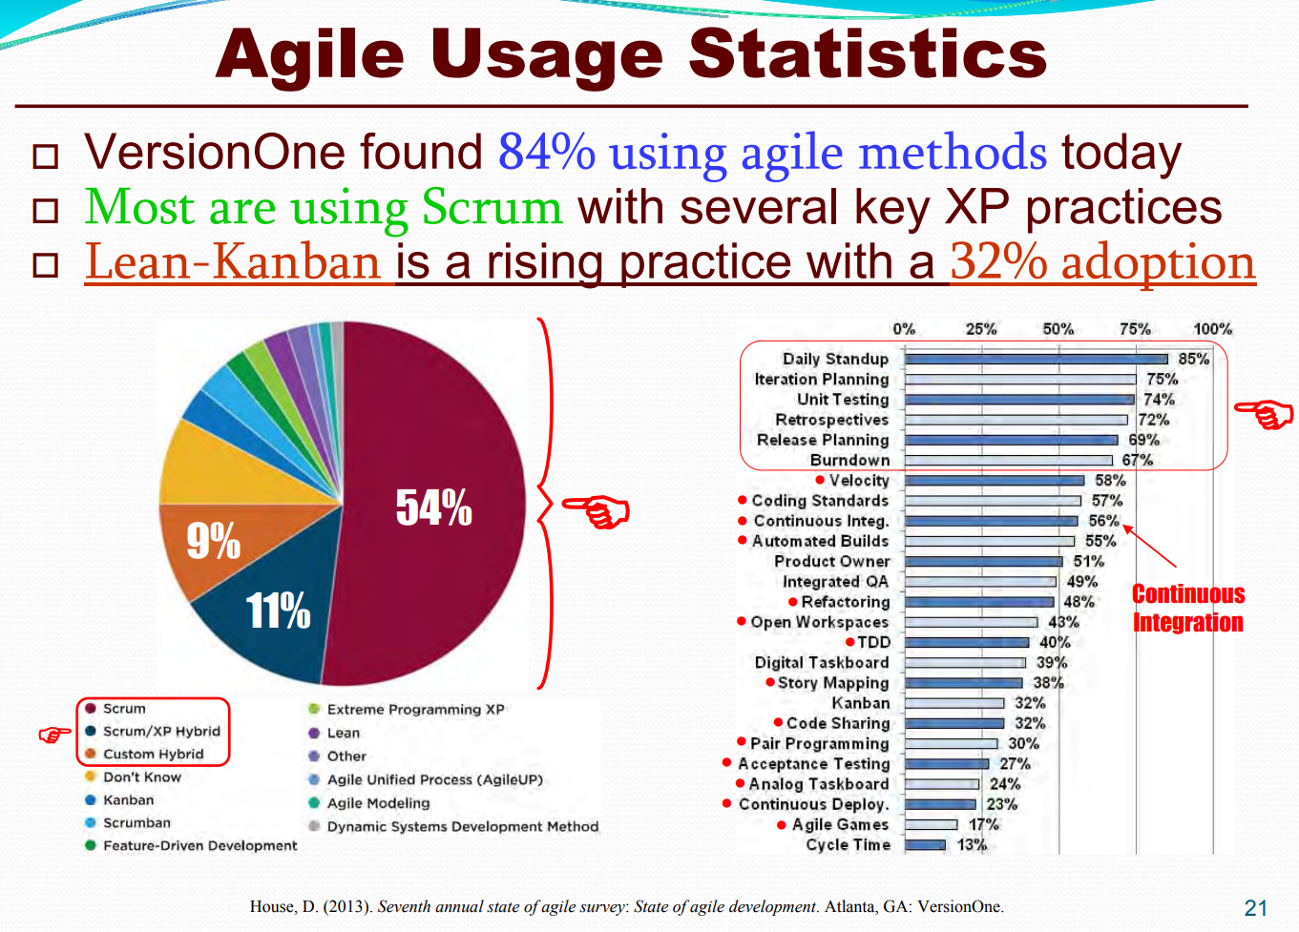
Types of Agile
Scrum
Kanban
Scrumban
Extreme Programming
Lean
Feature Driven Development
Dynamic Systems Development Method
Agile Unified Process

Slide 5
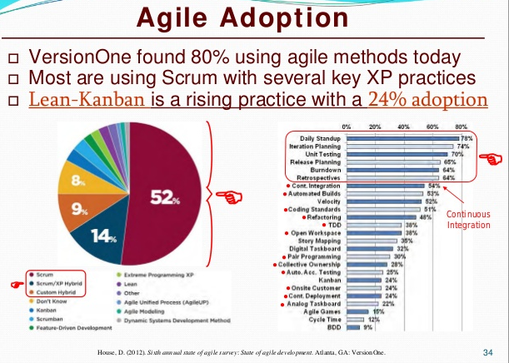

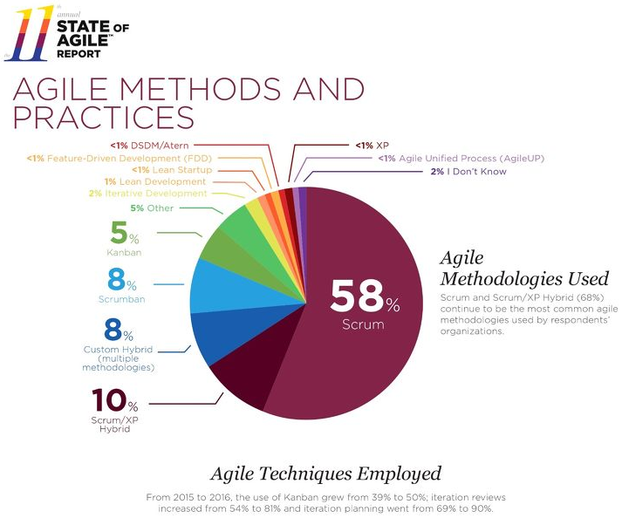
2015-2016
2012
2013

Slide 6
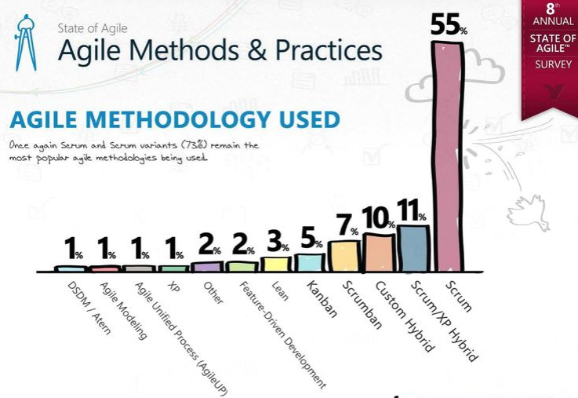
2013

Slide 7
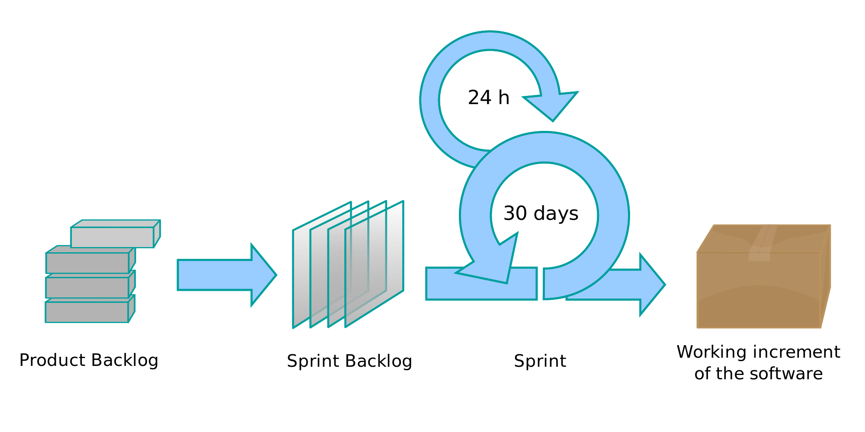
Scrum

Slide 8
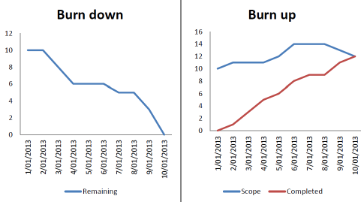
Scrum

Slide 9
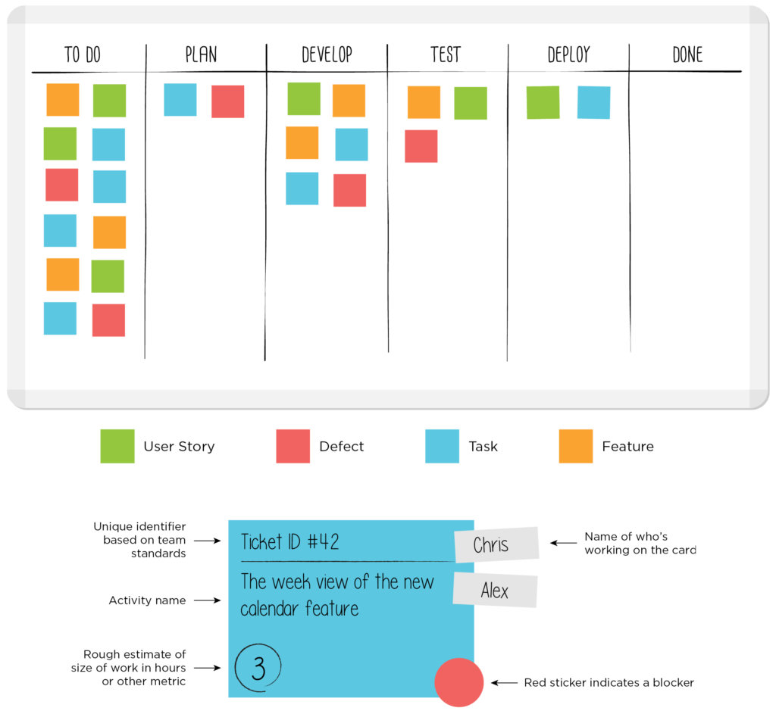
Kanban
Japanese word meaning “visual card” indicating a visual representation of important information
Visualize your work, limit your work in process, focus on flow, and practice continuous improvement.
Columns/Lanes
Swimlanes
Done criteria
WIP limits

Slide 10
Kanban
The columns are usually:
To Do
Plan
Develop (In process / Done)
Test
Deploy
Done
The simpler version uses only three columns:
To Do
In process
Done

Slide 11
Kanban
Data on the Kanban cards:
Unique task ID
Activity name
Estimated scope of the task in hours
Who’s working on the card
Possible blocker status
Blockers
Tasks that can’t continue without some other work being finished
Can be moved to another section in the column so as not to affect the WIP limit
When task is no longer blocked, can be moved back to continue progress as soon as WIP limit allows (will be placed at higher priority so it will be the next task to be put into the lane)

Slide 12
Scrumban
Originally designed as a way to transition from Scrum to Kanban
But then became a technique in its own right
Is used by some companies as their main software process
It looks somewhat like Scrum at the practice level, but at the cultural level it will look like Kanban – soft evolution rather than shock treatment and revolution

Slide 13
Scrum v. Kanban
Scrum:
Small, cross-functional, self-organizing teams.
User stories sorted by priority with story points on each
Potentially shippable code demonstrated after each sprint.
Limits work in progress by using sprints to batch tasks in the product backlog
Inspection and review done after each sprint to optimize the release plan and update priorities in collaboration with the customer.

Slide 14
Scrum v. Kanban
Kanban:
Visualize the workflow
Split the work into smaller items, write each item on a card, and put it on the wall.
Use named columns to illustrate where each item is in the workflow.
Limits work in progress by limiting the amount of items in each column
Except for the first (product backlog) and last (done) columns
Measures the lead time (average time to complete one item, sometimes called “cycle time”), and optimize the process to make lead time as small and predictable as possible.

Slide 15
Scrum v. Kanban
Both:
Uses the concept of lead time (time between entering the backlog column until being placed in the done column for a task) as a metric to optimize the process
Also examines the cycle time (time between entering an “in process” column indicating actual work has been started until being placed in the done column for a task) as a metric to optimize the process
Both of these metrics should be small and predictable
Are agile methods (although Kanban can be seen as “more agile”)

Slide 16
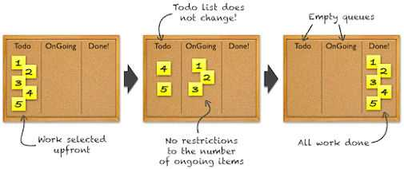
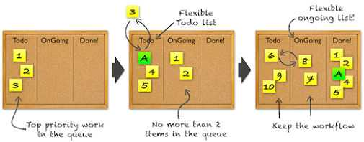
Scrum
Kanban

Slide 17
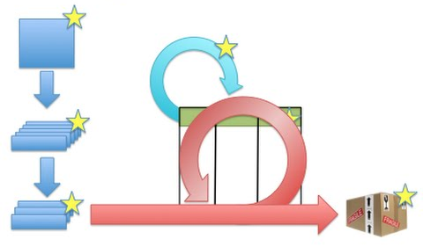
Scrumban
Product Vision
Stays the same
Product Backlog
Becomes our ‘Todo’ column
Global backlog for the project
Sprint Backlog
Becomes our ‘Ready’ or ‘Plan’ column
The tasks that are ready to be executed next
Daily Standup
We should still communicate every day
Sprint Cycle
Replace this with our Kanban board
Product
Vision
Daily
Standup
Product
Backlog
Sprint
Cycle
Shippable
Product
Sprint
Backlog

Slide 18
Scrumban
Product
Vision
Daily
Standup
ToDo
Kanban
Shippable
Product
Plan/
Ready

Slide 19
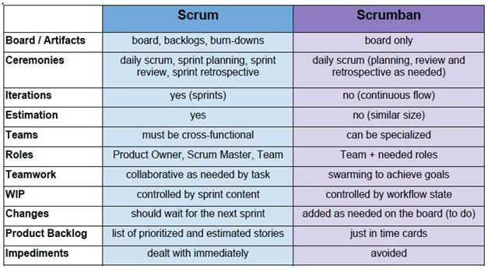
Scrumban

Slide 20
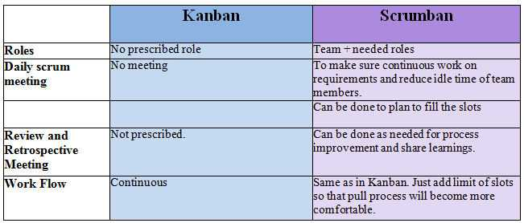
Scrumban

Slide 21
Video on Scrum and Kanban
This video does a fantastic job at explaining the difference between Scrum and Kanban and gives you an idea on merging the two.
https://www.youtube.com/watch?v=0EIMxyFw9T8

Slide 22
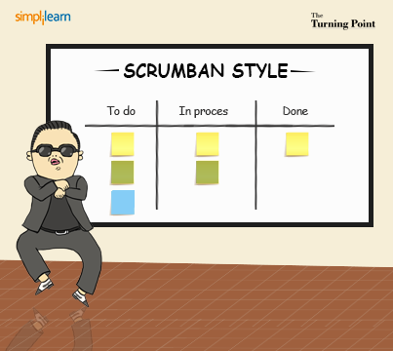

Slide 23
Glossary
Timeboxing
The concept of chopping work until timed periods (e.g. sprints)
GAAP
Generally accepted agile practice
IR
Interim release
Backlog grooming
Developers meet (normally once per sprint) to ensure the backlog is keep up to date, reprioritized if necessary, story points are estimated, acceptance criteria is added/updated and epic stories are broken down into smaller user stories.

Slide 24
Glossary
AC
Acceptance criteria
ACDD
Acceptance criteria driven development. This is using the acceptance criteria of a user story to write your tests and integrate TDD. Basically this is what we are doing for our sprint team project assignment.
PO
Product owner
NFR
Non-functional requirement

Slide 25
Glossary
Scope/Feature Creep
Constantly adding new features to a project past the initial requirements
Lead time
Time from when a user story enters the product backlog to when it is completed
Used as a metric for process improvement
Cycle time
Time from when a user story enters the in progress phase (work begins on it) to when it is completed
Also used as a metric for process improvement

Slide 26
Software that Companies are Using
TFS
JIRA
Git
Perforce
Confluence
Trello
Jenkins

Slide 27
References
https://s3.amazonaws.com/scrumorg-website-prod/drupal/inline-images/2017-05/ScrumFrameworkTest.png
http://www.clariostechnology.com/productivity/blog/burnupvsburndownchart
https://leankit.com/learn/kanban/kanban-board/
https://agileleanlife.com/kanban-visualize-workflow/
https://en.wikipedia.org/wiki/Scrumban
https://www.agilealliance.org/what-is-scrumban/
https://community.dynamics.com/crm/b/microsoftdynamicscrmsolutions/archive/2015/11/19/agile-methodology-and-project-management

Slide 28
References
https://www.onedesk.com/waterfall-vs-agile/
https://explore.versionone.com/state-of-agile
https://www.scrumalliance.org/community/articles/2014/june/lean-agile-process
https://www.scrumalliance.org/community/articles/2014/march/acceptance-criteria-driven-development
https://www.youtube.com/watch?v=0EIMxyFw9T8
https://lh4.googleusercontent.com/-sjDHoRrQKeo/UULFWLHFeJI/AAAAAAAABHM/Ez69DPjhhhM/w506-h750/scrumban_style_fb.png
https://www.youtube.com/watch?v=Ht4S3Fs6COQ

